Slide 1
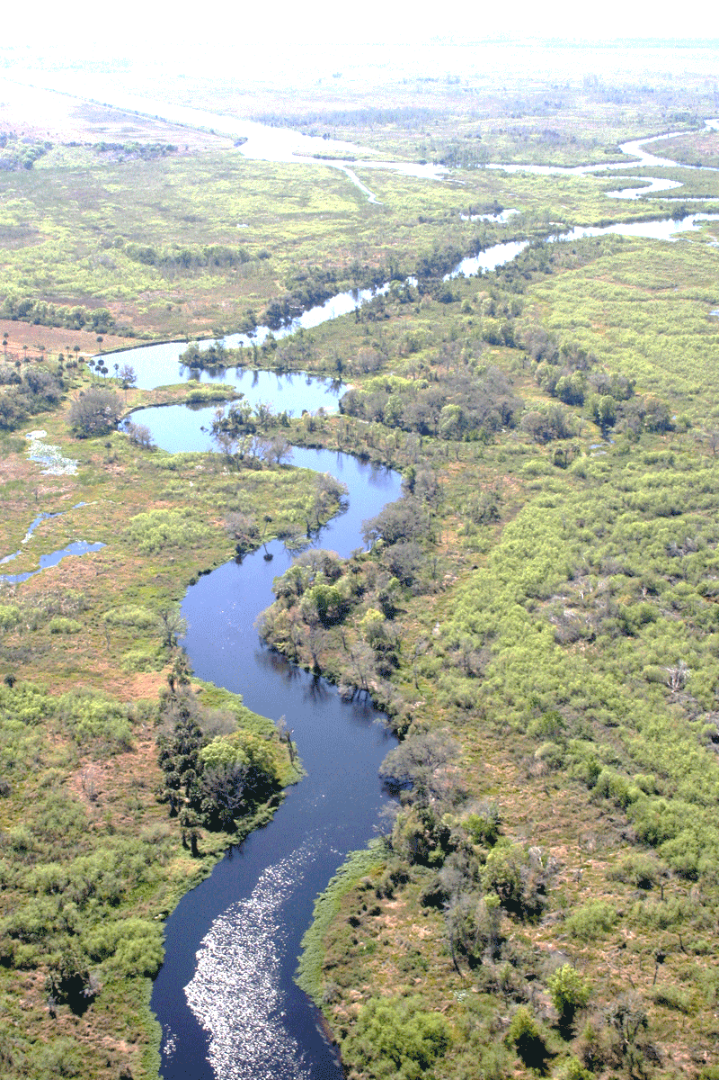
Colorado Basin River Analysis
Colorado Basin Team: Jerry Brooke, Karr Davis, Bruce Jones, Shubh Patel
February 2023
This Photo by Unknown Author is licensed under CC BY-SA-NC

Slide 2
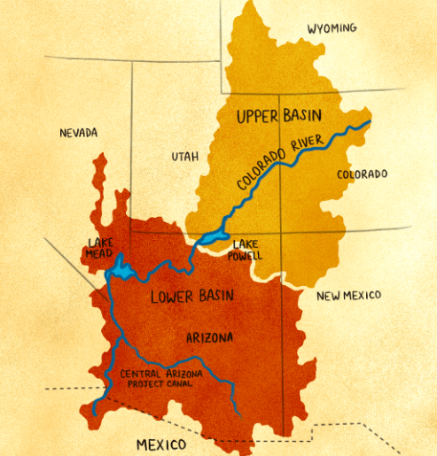
Introduction
Colorado River Basin (CRB) TEAM
Jerry Brooke
Karr Davis
Bruce Jones
Shubh Patel
Project Overview
Analysis
Summary/Conclusion
Questions
Image source: https://grist.org/equity/colorado-river-drought-indigenous-water-rights/

Slide 3
Colorado River Basin Analysis
Topic
Focuses on drought conditions within the Colorado River Basin (CRB)
Explores if the Rocky Mountain snowpacks and the water levels of Lake Mead and Lake Powell may be used to determine future drought levels
Why Interested
Climate change impact on region
Water Conservation Measures
Explosive population growth in the region
Target Question:
Does the Rocky Mountain snowpack and the 2 major reservoirs’ water levels impact the CRB drought status?
Method:
Utilized a Machine Learning model using the Logistic Regression (Classification) methodology

Slide 4
Data Exploration
Data Exploration
Lake Mead and Lake Powell water storage
Colorado River Headwaters/Rocky Mountain Snowpack
Colorado Basin Drought data
Other Regional Demographic and Weather System data
Extract Process
For each dataset, the data was queried and .csv formatted files were extracted. The .csv datasets are as follows:
Drought for the CRB as percent area
Colorado River headwaters: Rocky Mountain snowpack as snow water equivalent (SWE) in inches
Lake Mead & Lake Powell water storage in square feet

Slide 5
Data Exploration cont.
Transformation Process
We reformatted the four .csv files in order to merge into a single dataset for our Machine Learning model.
Load Process
Loaded the single merged .csv into our Machine Learning code
Single merged .csv can be leveraged by future analyst for additional analysis
Building a database for this low volume of data would be unnecessary overhead
Notes:
Merged on Year and Month

Slide 6
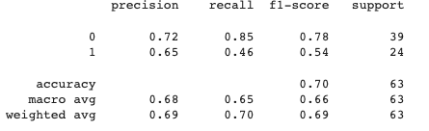
Data Analysis
Data Analysis:
CRB dataset contained over 250 records
Utilized a few techniques to train and evaluate models based on the drought data
Final training score of 68% and testing score of 70%.
In analyzing the data via Supervised ML
Accuracy score: 70%
Drought Severity Low (0): precision: 72%, recall 85%
Drought Severity High (1): precision: 65%, recall 46%
F1 score: 78%
Notes:
Additional Features Tested:
El Nino & La Nina Index Value
Had no impact on the Accuracy Score for the overall model.
Executed a PCA analysis
Machine Learning model determined the Variance was too weak to impact the data results or predictions.

Slide 7
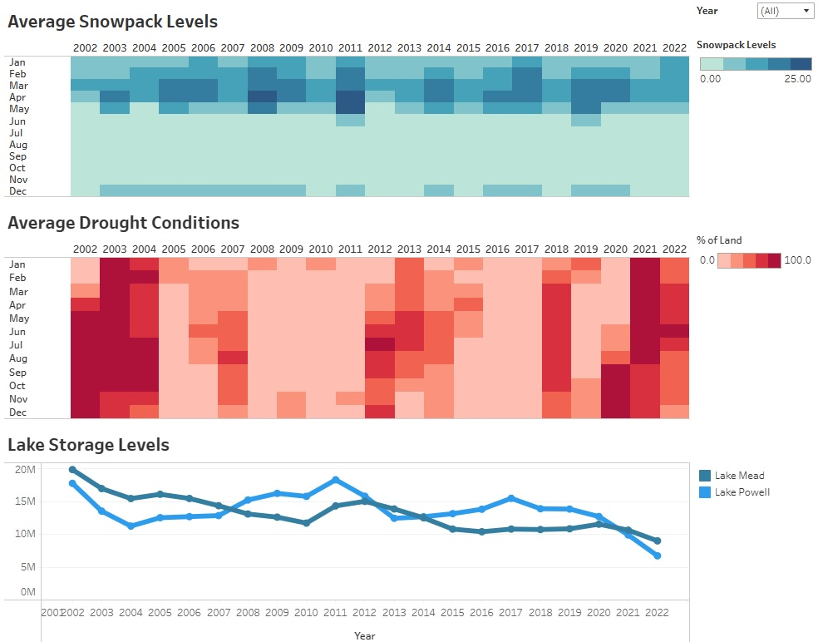
Data Exploration & Analysis
Based on the analysis,
When Snowpack levels are high, Drought conditions are low
When Snowpack levels are low, the Drought conditions are high
The same holds true as it relates to the Lake Storage levels
When Lake Storage levels are high, Drought conditions are low
When Lake Storage levels are low, Drought conditions are high
Tableau Storybook Analysis Link

Slide 8
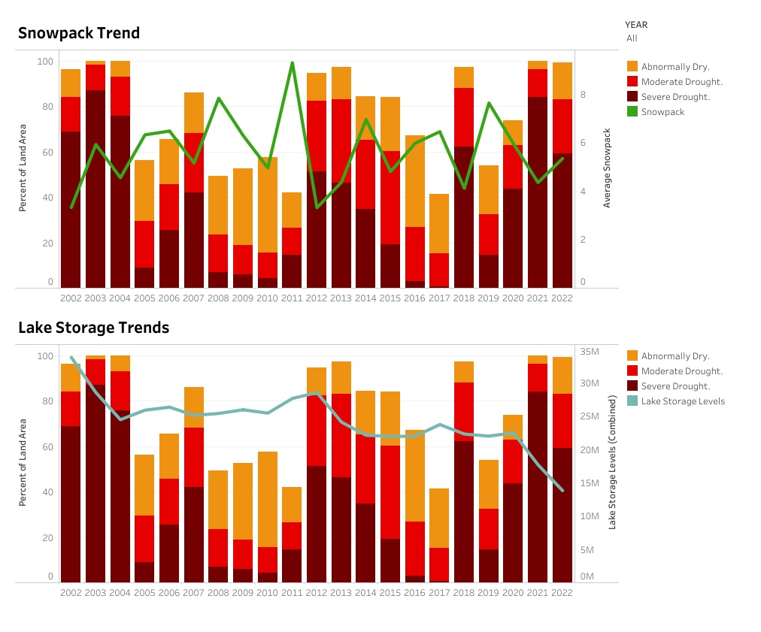
Data Exploration & Analysis
Tableau Storybook Analysis Link

Slide 9
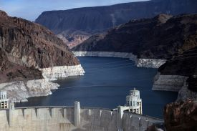
Summary
The Colorado River Basin is a complex region with major water issues…
Explosive population growth
Expansive agriculture areas
Extreme climate change
Models such as the one we developed are greatly needed to make the drought predictions for these types of regions that are under constant pressure on water usage.

Slide 10

QUESTIONS ?

Slide 11
Appendix

Slide 12
Technology and Algorithms
The tools and algorithms utilized for the CRB Analysis are as follows:
Jupyter Notebook
Pandas
PostgreSQL
Quick DBD
Tableau
SKLearn

